Slide 1
POWER SYSTEM FAULT DETECTION AND CLASSIFICATION USING MACHINE LEARNING
CAPSTONE PROJECT
Presented By:
1. RISHI YADAV CMR ENGINEERING COLLEGE AIML

Slide 2
OUTLINE
Problem Statement (Should not include solution)
Proposed System/Solution
System Development Approach (Technology Used)
Algorithm & Deployment
Result (Output Image)
Conclusion
Future Scope
References

Slide 3
Problem Statement
Power distribution systems are prone to various types of faults such as line-to- ground, line-to-line, and three-phase faults. These faults can disrupt power supply and reduce system reliability. The challenge lies in accurately detecting and classifying these faults using electrical measurement data (voltage, current, phasors) to differentiate them from normal operating conditions, thereby ensuring the stability of the power grid.

Slide 4
Proposed Solution
Develop a machine learning model that classifies power system faults using the dataset provided. The model will process electrical measurements to identify the type of fault rapidly and accurately. The classification will help automate fault detection and assist in quicker recovery actions, ensuring system reliability.
Key components: Data Collection: Use the Kaggle dataset on power system faults.
Preprocessing: Clean and normalize the dataset.
Model Training: Train a classification model (e.g., Decision Tree, Random Forest, or SVM).
Evaluation: Validate the model using accuracy, precision, recall, and F1-score.

Slide 5
System Approach
The "System Approach" section outlines the overall strategy and methodology for developing and implementing the power system fault detection and classification. Here’s a suggested structure for this section:
System requirements:
IBM Cloud(mandatory)
IBM Watson studio for model development and deployment
IBM cloud object storage for dataset handling loping

Slide 6
Algorithm & Deployment
In the Algorithm section, describe the machine learning algorithm chosen for predicting bike counts. Here's an example structure for this section:
Algorithm Selection:
Random Forest Classifier (or SVM based on performance)
Data Input:
Voltage, current, and phasor measurements from the dataset
Training Process:
Supervised learning using labeled fault types
Prediction Process:
Model deployed on IBM Watson Studio with API endpoint for real-time predictions

Slide 7
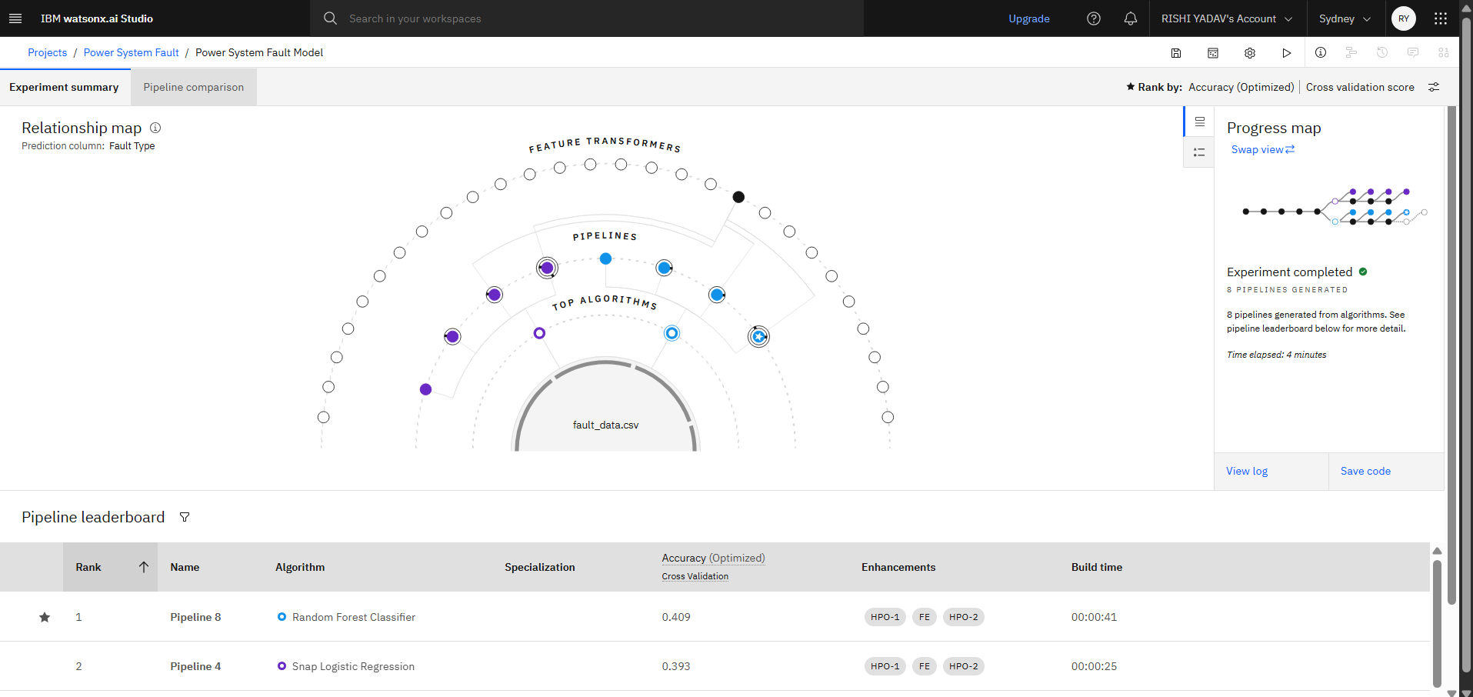
Result

Slide 8
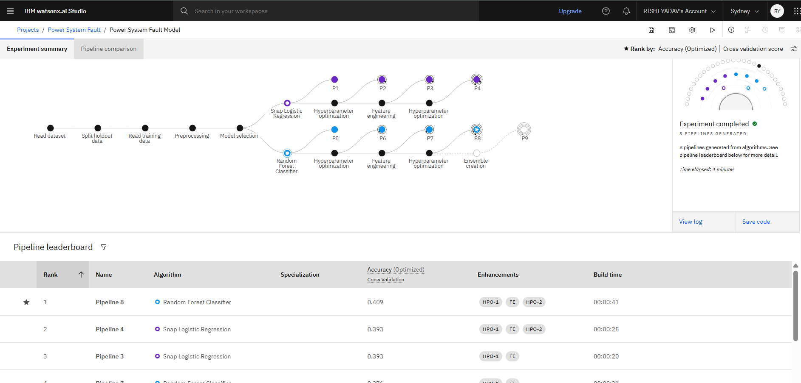
Result

Slide 9
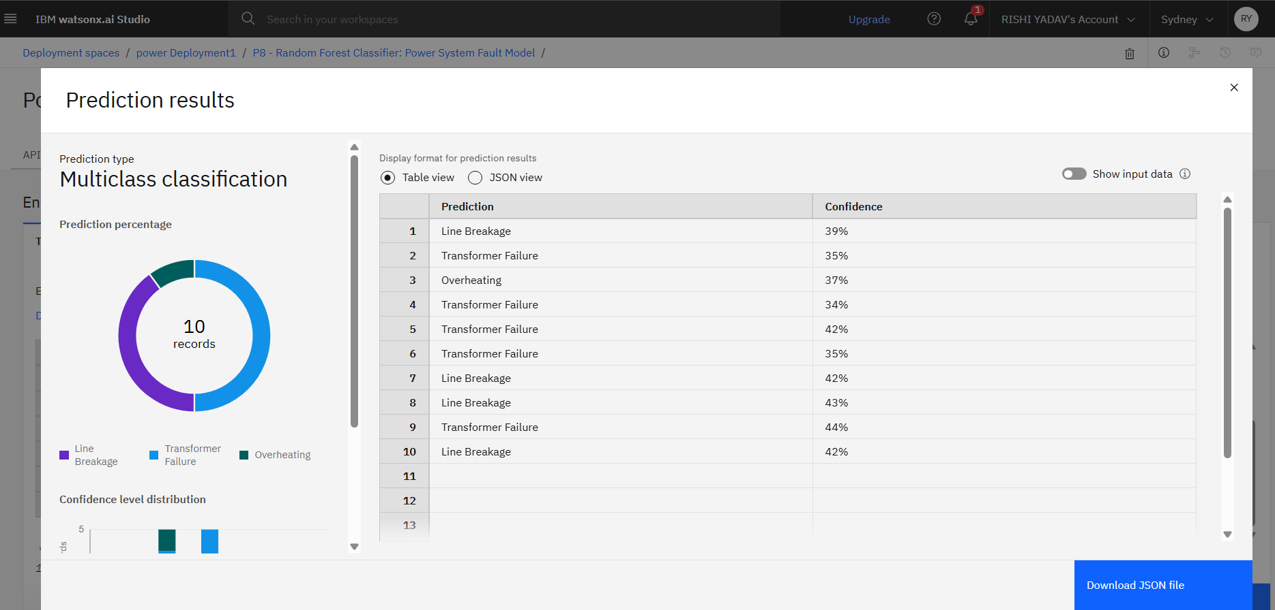
Result

Slide 10
Conclusion
The developed machine learning model successfully achieves accurate and rapid detection and classification of power system faults by analyzing voltage and current phasor data. By distinguishing between normal operations and various fault types—such as line-to-ground, line-to-line, and three-phase faults—the model demonstrates its capability to support real-time decision-making in power grid operations.
This approach not only improves fault response time but also enhances the overall reliability, safety, and stability of the electrical power distribution system. The integration of such intelligent systems marks a significant step toward the automation and modernization of fault management in smart grids.

Slide 11
Future scope
Real-Time Deployment: The model can be integrated into real-time monitoring systems for live fault detection and instant alerts, improving operational response and minimizing downtime.
Scalability to Larger Grids: With further training and optimization, the model can be scaled to handle complex and large-scale power networks, including smart grid and renewable energy systems.
Incorporation of Deep Learning: Advanced deep learning architectures like LSTM or CNN can be used to improve classification accuracy, especially in detecting subtle or mixed faults.
Edge Computing Integration: Deploying the model on edge devices (e.g., substation controllers) can enable local decision-making without relying on centralized servers, reducing latency.
Multi-Fault Detection and Prediction: Future work can focus on detecting simultaneous or evolving faults and predicting fault occurrence based on historical patterns and environmental factors.
Adaptive Learning: Implementing online learning techniques will allow the model to adapt continuously to new grid conditions, improving its robustness over time.

Slide 12
References
Kaggle Dataset "Power System Fault Detection Dataset”
IBM Cloud "IBM Cloud Platform for AI Model Deployment." IBM Cloud, www.ibm.com/cloud
IEEE Papers (Optional, if consulted) If you referred to any IEEE or research articles for theory or model inspiration, include those here in IEEE format.

Slide 13

IBM Certifications

Slide 14

IBM Certifications

Slide 15
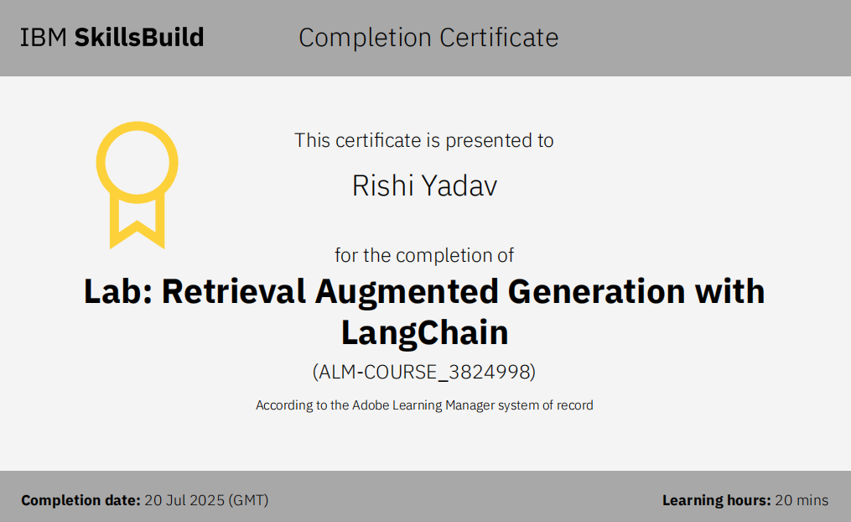
IBM Certifications

Slide 16
THANK YOU

